Slide 1
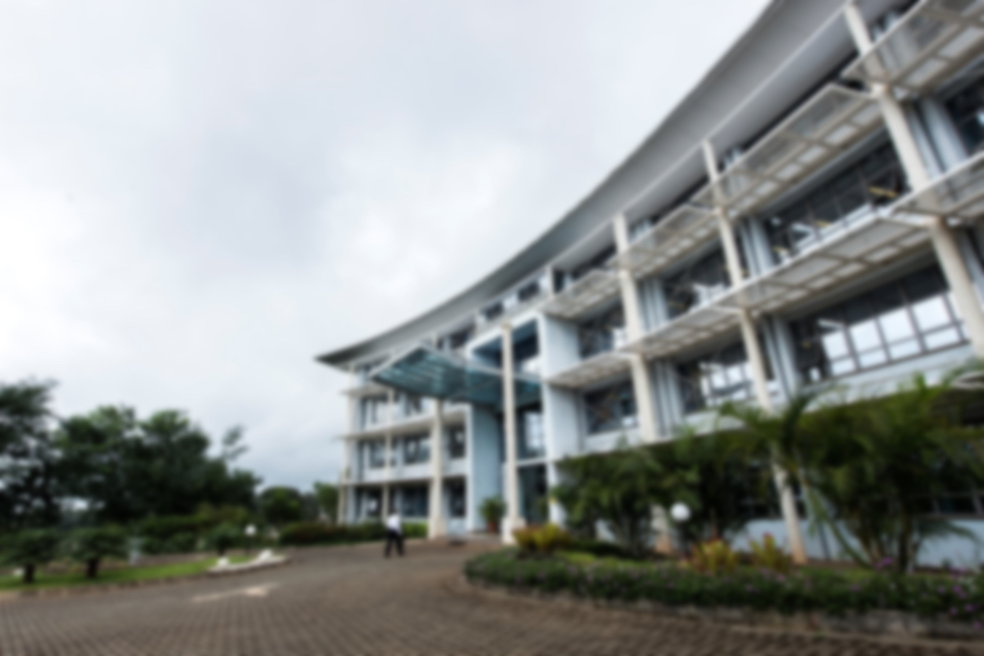

2023 Annual Performance Review Report Key Highlights
Prepared by
Measurement, Evaluation, and Learning (MEL) Unit

Slide 2
Overview
Reporting period – January-December 2023
Projects Profile
Performance of the SP objectives
SP KPIs Performance Summary
Key Challenges, Lessons Learnt And Recommendations

Slide 3
Projects Profile

Slide 4
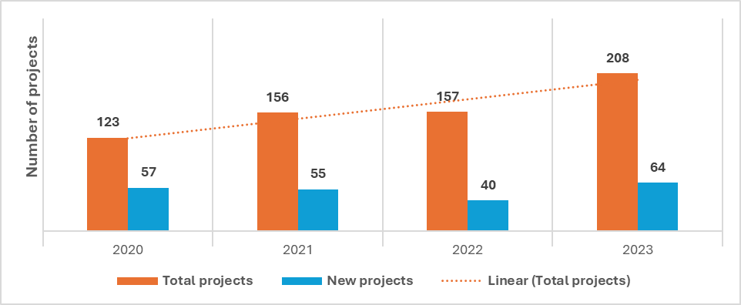
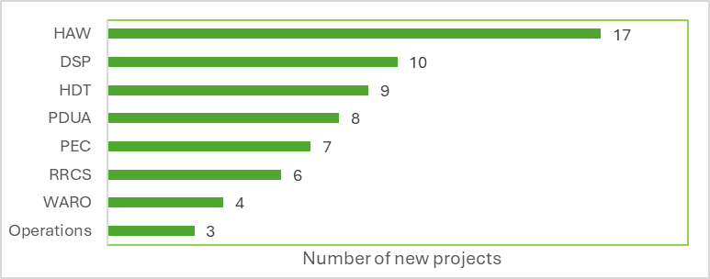
Projects implemented in 2023
This year recorded the highest number of projects with a steady increase from 157 in 2022 to 208 in 2023.
This year also had the highest number of new projects compared to the previous 3 years.
HAW and DSP had the highest number of new projects at 17 and 10 resp.
Notes:
The total number of projects in 2023 is attributed to the increased number of new projects. In 2023, the 7 CARTA project grants are counted as individual projects and not as one project as previously done. This was done to align to the APHRC financial reporting. This change will now be taken up going forward.

Slide 5
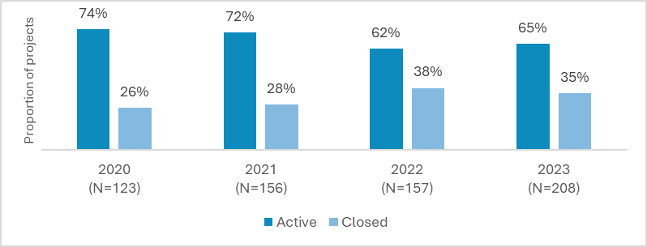
Active and Closed Projects
By the end of 2023, 65% (135) of the projects were active while 35% (73) closed.

Slide 6
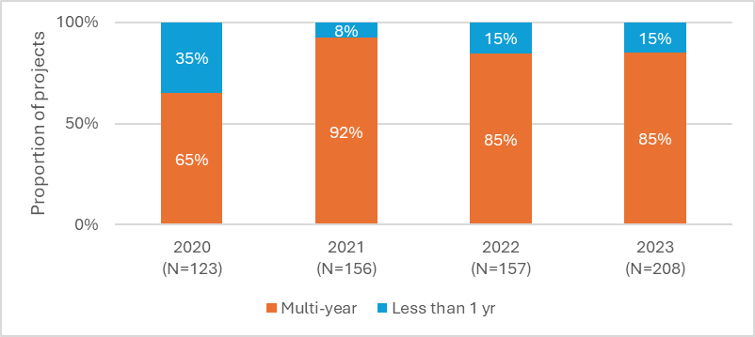
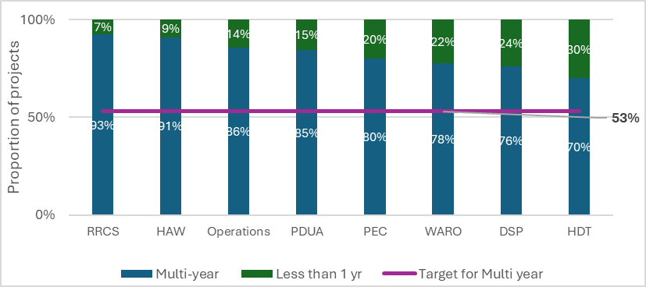
The 3Ms- Multi-Year Projects
85% (177) of the projects were multi-year while 15% (31) were projects that were running for less than one year.
This surpassed the set 2023 target of 53% of the projects as multi-year
All the themes surpassed the 2023 target of 53% of projects being multiyear projects.

Slide 7
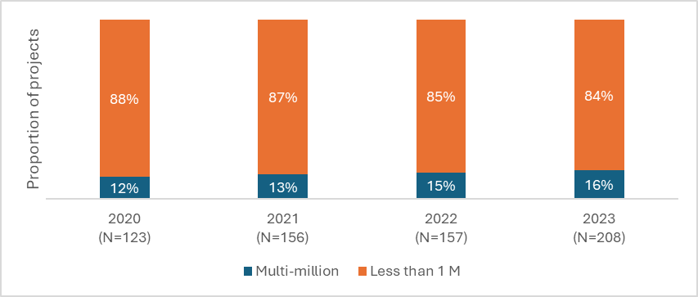
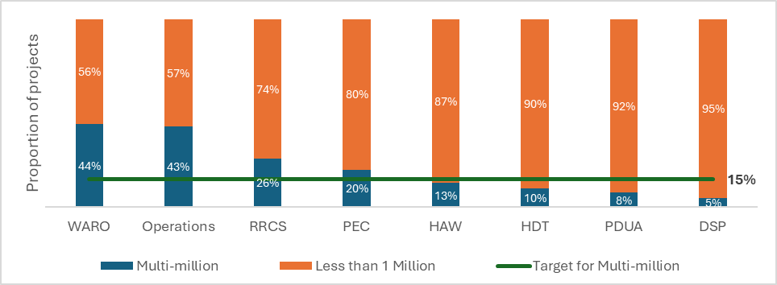
3Ms - Multi-Million Projects
In 2023, 16% (33) of the projects were multi-million while 84% (175) were less than USD 1 million.
Slightly surpassing the multi-million target for 2023 was 15%.
This was an increase from 2022 where 15% (22) projects were Multi-million.
Half of the themes surpassed the 15% target for proportion of projects that are multi-million.
The highest was WARO at 44% and Operations at 43%.

Slide 8
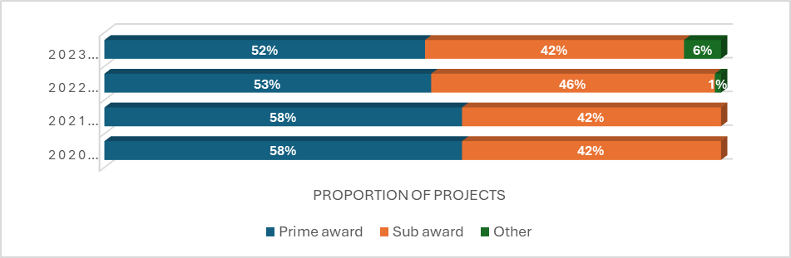
Prime v/s Sub-Award
The monetary value of the prime award projects contributed 79.9% (USD 127.1M) of the total lifetime value of the projects implemented in the year 2023.
Almost half, 52% (109) of the projects in 2023 were prime awards, a slight decrease compared to 2022 and 2021.
Others include projects that were consultancies.

Slide 9
2023 Top Funders
The Center had 95 funders providing USD 159.3 million in total lifetime monetary value of grants. The top 5 funders of 2023 were:
BMGF USD 41,681,060
SIDA USD 25,668,342
Wellcome Trust USD 20,094,678
IDRC USD 8,361,524
RTI International USD 6,679,766
BMGF, SIDA, and Wellcome trust contributed 55% of the total lifetime monetary value of projects implemented in 2023.

Slide 10
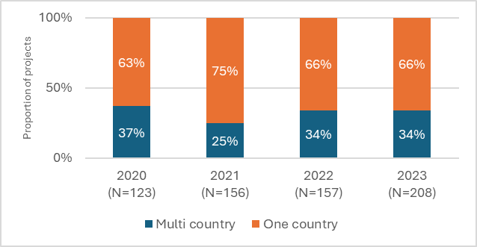
The 3Ms- Multi-Country Projects
The Center had 34% (70) of the projects implemented in more than one country. This was similar to 2022.
The Center also surpassed the set target of 30% of projects being multi-country.
The Center had 5 projects implemented in more than 10 African countries:
Gates Countdown 2030 Phase 2 (WARO) – 28
Gavi - Immunization Coverage and Inequalities (WARO) - 23
CD 2030 Phase III (WARO) - 22
World Bank - RMNCAH-N (WARO) - 22
IDRC-Women RISE HPRO (PEC) - 17
Notes:
1. IDRC-Women RISE HPRO (PEC) in 17 countries
2. CD 2030 Phase III (WARO) in 22 countries
3. World Bank - RMNCAH-N (WARO) in 22 countries
4. Gavi - Immunization Coverage and Inequalities (WARO) in 23 countries
5. Gates Countdown 2030 Phase 2 (WARO) 28 in countries

Slide 11
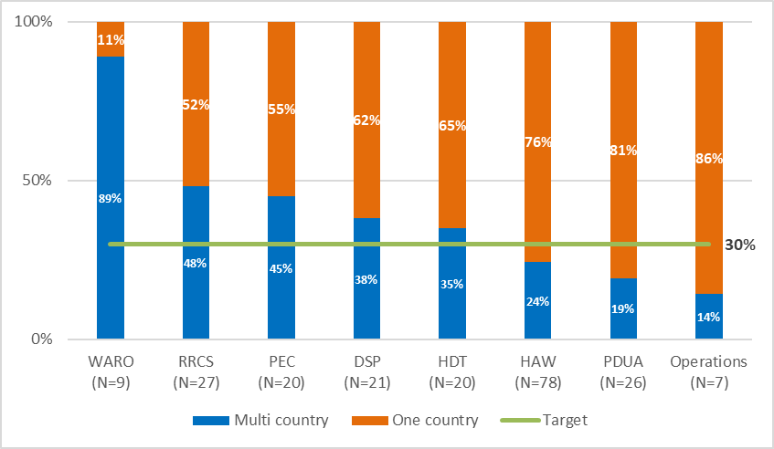
The 3Ms- Multi-Country Projects cont…
Half of the themes surpassed the 30% target for proportion of projects that are multi-country.
The highest was WARO at 89% and RRCS at 48%.

Slide 12
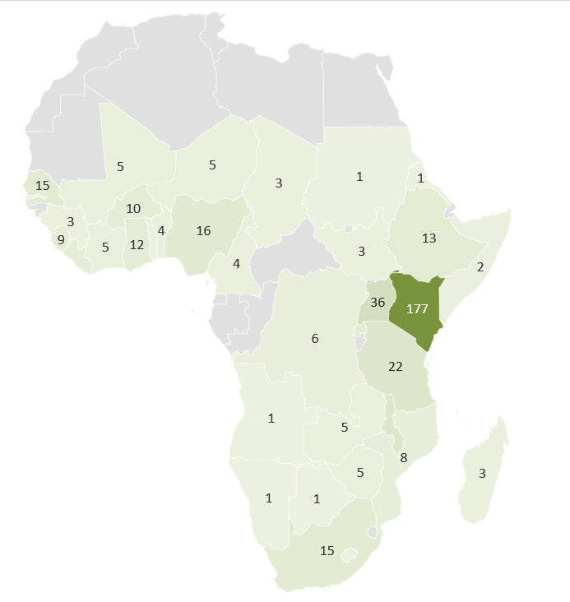
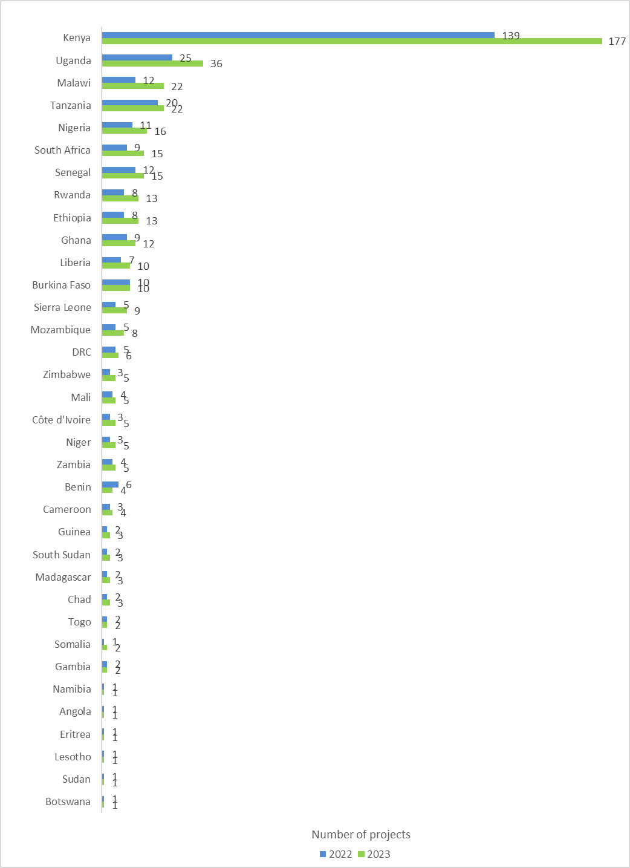
Countries projects are implementing activities
+ 38
-2
In 2023, projects were implementing activities in 35 African countries, similar to 2022.

Slide 13
Business Development

Slide 14
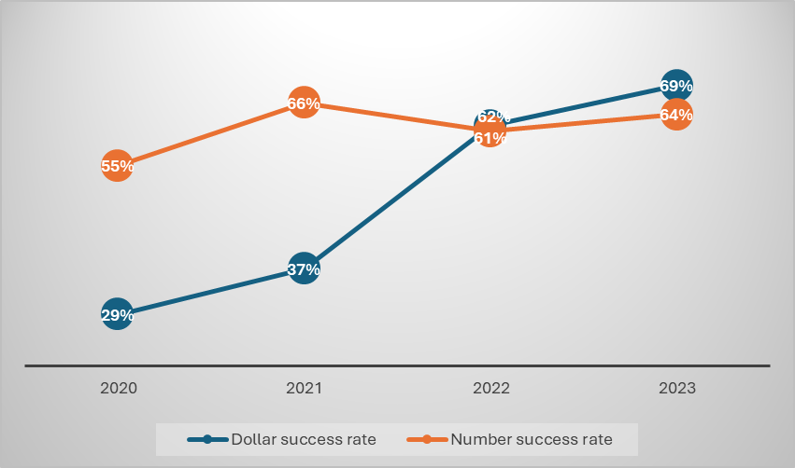
Proposal Success Rates
In 2023, the Center submitted 101 proposals with a number success rates of 64% an increase from 2022 at 62%. This was, however, below the set target of 66% for 2023.
The Center recorded the highest dollar success rate in the last 4 years at 69% surpassing the set 2023 targets of 38%.
Notes:
Comparatively, the Dollar success rate was higher than the number success rate as we were able to submit less proposals and win more USD in terms of proposal monetary value

Slide 15
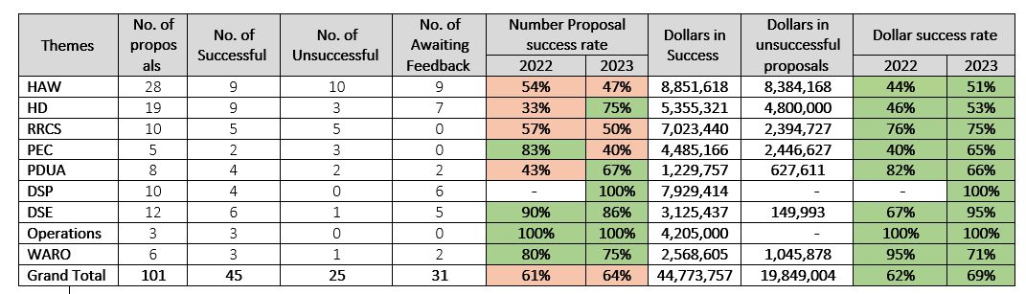
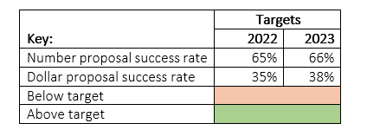
Proposal Tracker
Operations, DSP and DSE had the highest number and dollar success rates.
The Center raised a total of USD 43.7 million in successful proposals in 2023.
This was higher than 2022 and 2021 where successful projects were USD 30 million and 25.7 million resp.

Slide 16
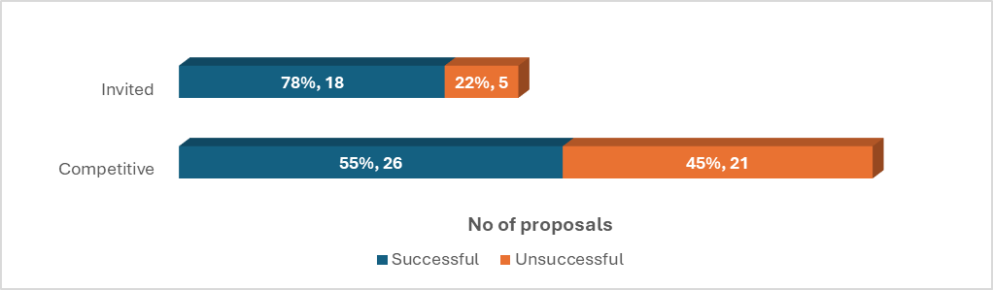
Competitive v/s invited proposals – success rates
Out of the 70 proposals that had received feedback, 23 were invited proposals while 47 were competitive proposals.
In 2023, 78% of the invited proposals that received feedback were successful while 55% of the competitive proposals that received feedback were successful.

Slide 17
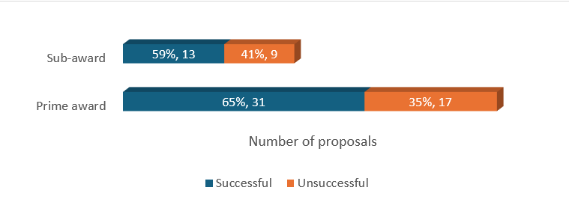
Prime vs subawards proposals
Out of the 70 proposals that had received feedback, 65% of the prime award proposals that received feedback were successful while 59% of the sub-award proposals that received feedback were successful.

Slide 18
Strategic Objective 1: Generate scientific knowledge aligned to local and international development agendas that affect health and development in Africa.

Slide 19
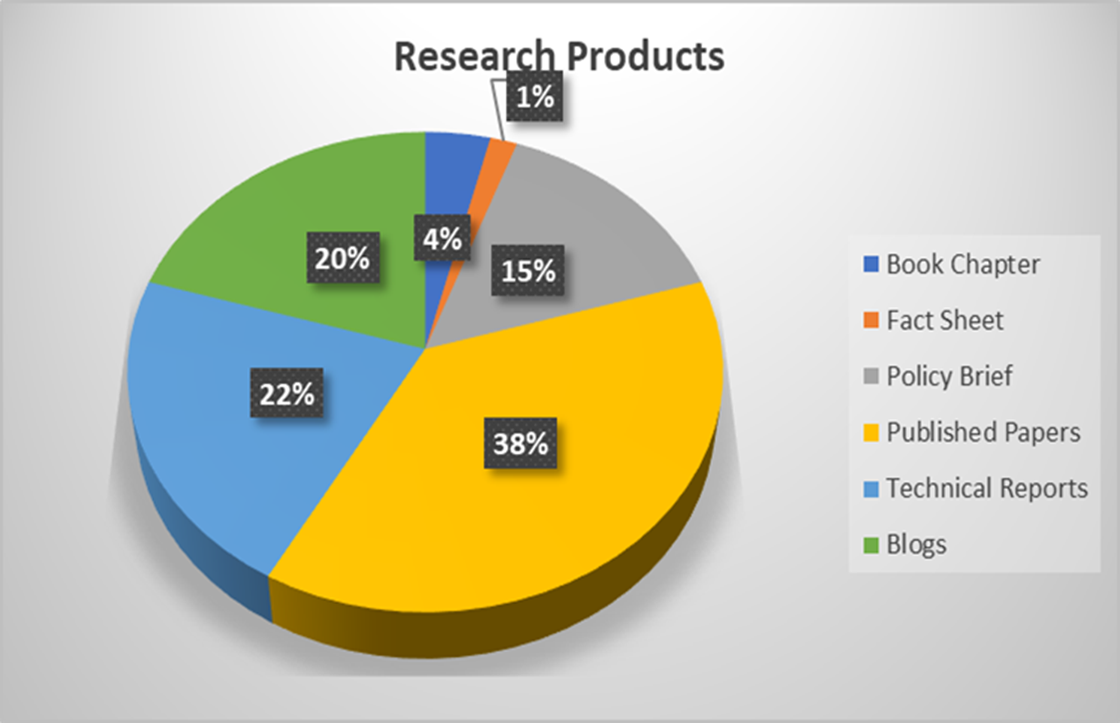
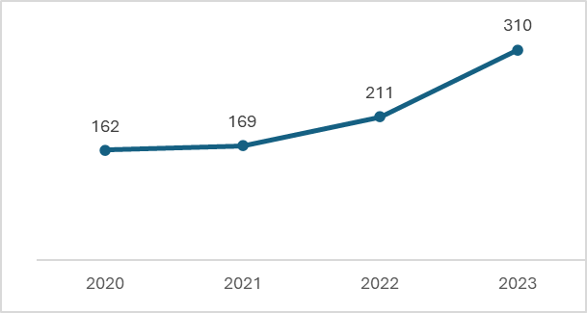
Research products
For the past 4 years, APHRC recorded an upward trajectory on number of research products published, with 2023 recording the highest.
Top 5 journals where the Center published in 2023 were:
1. Research Square
2. PLOS global public health
3. BMJ Open
4. Frontiers in Public Health
5. Reproductive Health

Slide 20
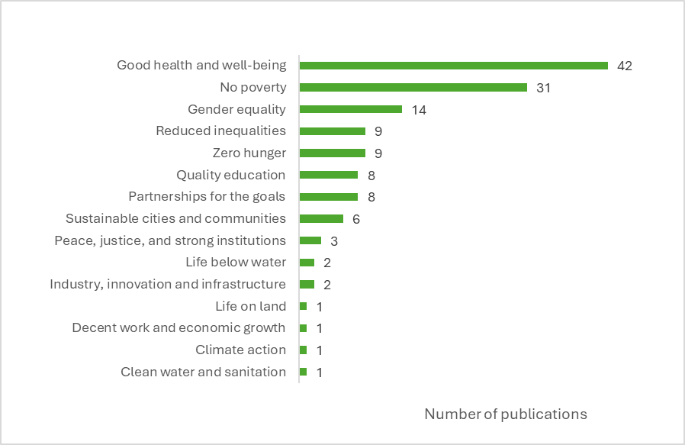
Impact of the Research Products
Citations
At end of 2023, APHRC publications had been cited a total of 46,905 times.
Most, 77%, of the Center publications have had been cited at least once.
Addressed the UN Sustainable Development Goals (SDGs)
Of the 17 SDGs, the Center’s research products informed 15 (88%) of them. Good Health and Well-being (SDG 3) and No Poverty (SDG 1) were the most addressed.
Notes:
Those examined, are those with DOI.

Slide 21
Objective 2 Develop capacities to strengthen the research ecosystem in Africa and contribute to the development and implementation of a blueprint for Africa’s self-sufficiency in R&D.

Slide 22
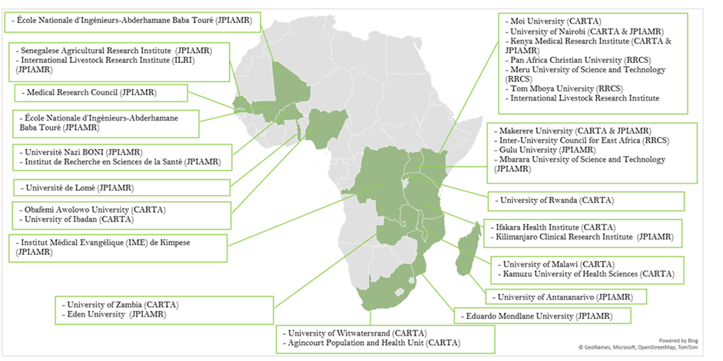
Capacity strengthening of African institutions
Partnerships with 33 African institutions for capacity strengthening
In 2023, there were 4 additional partnerships formed with universities and other related institutions under the RRCS.
These were Pan Africa Christian University, Inter-University Council for East Africa (renewed), Tom Mboya University, Meru University of Science and Technology (MUST)

Slide 23
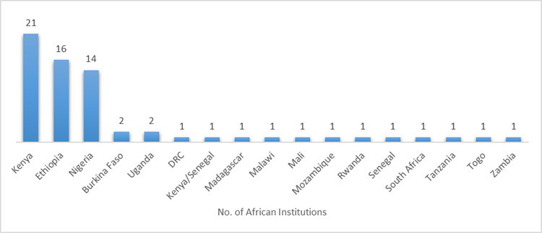
Cont…
Institutionalization of GFGP in partner institutions
In 2023, 67 African institutions actively underwent the Good Financial Grant Practice (GFGP) certification process.
-46 institutions under the Catalyze project, 12 under the JPIAMR project, and 9 under the CARTA
Establishment of research hubs across Africa institutions
In 2023, 5 institutions under CARTA were awarded preparatory grants for the initial conceptualization of research hubs and submitted extended concepts.

Slide 24
Capacity strengthening of individuals
CARTA
In 2023, CARTA had a total of 93 fellows: 78 doctoral, 6 post-doctoral, and 9 re-entry grant fellows.
5 doctoral fellows graduated which was a decrease from 2022 where 14 fellows graduated.
ADDRF
As at end of 2023, the ADDRF program had 29 ongoing fellowships (2 Master’s and 27 PhD fellowships).
3 Masters fellows who completed their fellowships, and this was increase from 2022 where no fellows completed their fellowship during the year.
Countdown 2030
By the end 2023, CD 2030 had 10 fellows.
Other fellowship programs
DIDIDA, WHO HRP Alliance had 2 and 4 fellows respectively by the end of 2023 with only 3 fellows graduated from WHO HRP Alliance.

Slide 25
Outcomes of the fellowships
Publication by fellows
CARTA fellows published 84 publications—a decrease from 2022, where fellows published 176 publications.
ADDRF fellows published only 2 papers.
JPIAMR partners published 5 papers
Grants won by fellows
During this year 24 CARTA fellows won a total of USD 31 million in grants a 656% increase from 2022 where fellows won USD 4.1 million worth of grants
Career Development
During the year 16 CARTA fellows advanced in their career where 9 were promoted from lecturer to senior lecturer, 4 from senior lecturer to associate professor, 1 from lecturer to professor and 2 from tutorial fellow to lecturer

Slide 26
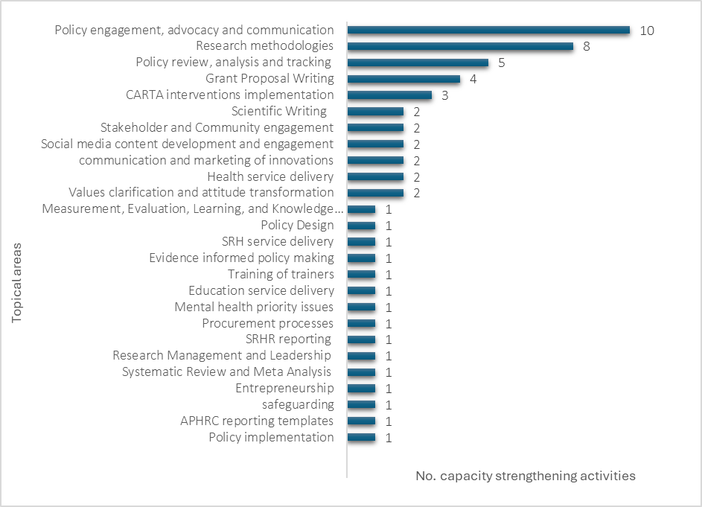
Other Capacity strengthening activities led by APHRC
There were about 54 capacity strengthening activities across the various themes.
Most of the capacity building activities organized, 78% (42), were for external participants only, while 9% (5) were for APHRC staff only and 13% (7) were for both APHRC staff and external participants.

Slide 27
Strategic Objective 3 Use research evidence and engage policy actors and practitioners for transformative change.

Slide 28
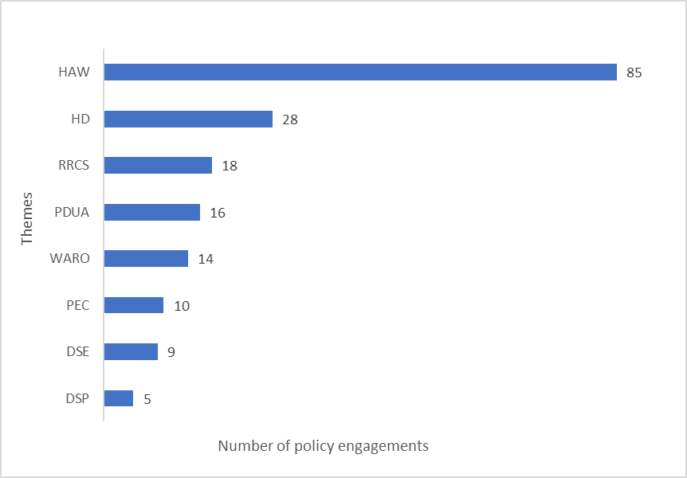
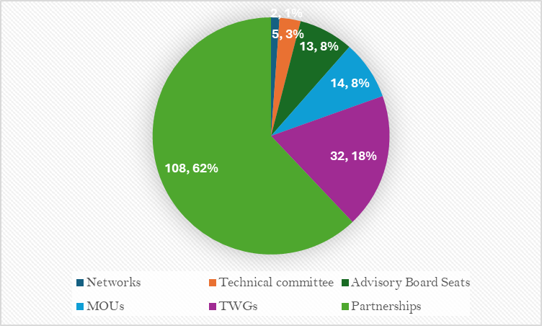
Policy engagement initiatives
In 2023, APHRC conducted about 185 policy engagements across various themes, reflecting a slight increase compared to 184 engagements in 2022.
HAW had the most engagements at 85, followed by HD at 28
APHRC formed alliances through 32 TWGs, 14 MOUs, 13 advisory board seats, 5 technical committees, and 2 networks,
APHRC had partnerships with 108 institutions

Slide 29
Potential Impacts/ Policy wins
Theme | Contribution to potential Policy wins for further Assessment
HAW | Development of the Kenya Nutrient Profile Model (KNPM) Development of guidelines on comprehensive post-abortion care (PAC) in Sierra Leone Development of Safe Motherhood and Reproductive Health Bill in Sierra Leone. The review of the Public Health Law in Liberia. Community Handbook for Engaging Adolescents, Parents and Community Leaders in Kenya Yet to be launched Adolescent and Young People Sexual and Reproductive Health (AYPSRH) Policy in Kenya The East Africa Community (EAC) Sexual and Reproductive Health and Rights bill 2021 Nairobi City County Public Health - food safety manual Development of the Kenya Verbal Autopsy Resource Hub through the VA technical working group.
HD | Parental empowerment and engagement (PEE) policy, guidelines and programs in Kenya Drafting of the childcare facilities regulations for Nairobi City County, Drafting of childcare regulations for Kajiado and Nakuru County Review and revision of the Kenya National ECD Policy and the Unpaid Care and Domestic Work Policy
Notes:
19 potential policy wins

Slide 30
Cont…
Theme | Contribution to potential Policy wins for further Assessment
PDUA | The Nairobi City County Assembly Bill on Child Headed Households (CHH) on Vulnerable and Marginalized Groups in Nairobi Informal Settlements.
RRCS | Wellcome is reviewing the requirements for the early career researchers (ECR) to be considered for their postdoctoral opportunities beyond 6 years after PhD graduation.
WARO | Informed the subsequent investment case for Liberia. Countdown country reports from 20 countries have been useful for RMNCH program planning and implementation in those countries The midterm review report for Kenya to inform the next SP for Health in Kenya
PEC | The Ministry of Finance in Sierra Leone committed to allocating funds towards Mental Health.

Slide 31
Strategic Objective 4: Strengthen operational efficiencies in systems and processes for maximum programmatic impact.

Slide 32
Strengthen operational efficiencies
New relationships developed for strategic initiatives
During 2023, the Center developed 8 new relationships that had formal Teaming Agreements.
Funding management portfolio
The Center had 3 active fund management projects: namely, JPIAMR, RELI Fund Management, and Collective Rising Leadership.
Efficiency in implementing projects - (timeliness)
Of the 73 projects that were scheduled to close, 11% (8) received approved extensions.
Enhanced System Thinking
Recruited a consultant in systems thinking to lead the approach
Notes:
The 8 new relationships aligned with APHRC’s strategic initiatives are:
EnCompass
Stawisha Africa Initiative
International Rescue Committee
Collective Rising Leadership Initiative
Sight Savers
New Horizons Global Health Labs
Oxford Management Policy Limited
Connexus

Slide 33
Cont…
Efficiency in the board of functions
Board skills matrix was approved. The Board documents such as the Committee ToR, development of the Code of Ethics, Board Manual, and guidelines on approval of policies were reviewed.
Audit committee of the board held four formal meetings. Decisions arising from the audit committee meetings were addressed with some action points being deferred to 2024.
Internal audit, risk and compliance
Internal audit unit planned 8 audits. Out of which 6 were successfully completed, 1 was differed due to an external audit and 1 is still ongoing.
Review of the Center’s risk management processes facilitated by a consultant led to the development of 5 functional risk registers and 1 strategic register.
Enhance environmental sustainability
Fully transition to paperless systems. - most finance payments, bid analysis, and approval of payment vouchers via ERP portal.

Slide 34
SP KPIs Performance Summary

Slide 35
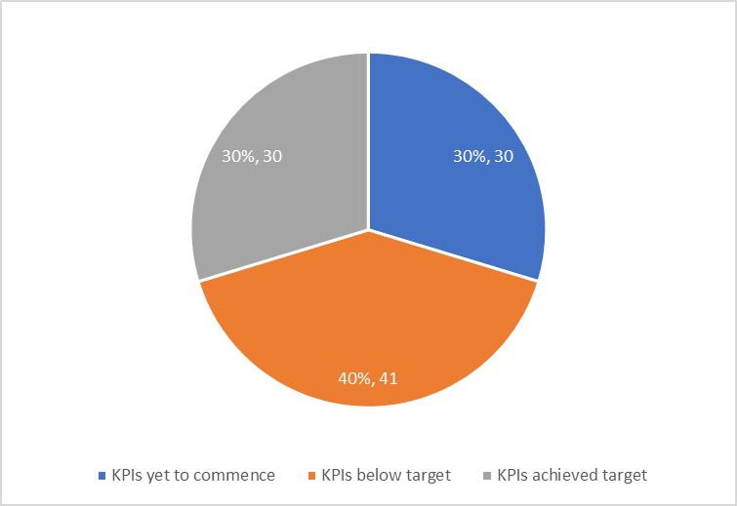
KPIs Performance - Summary
In total, there were 101 Key Performance Indicators (KPIs) associated with the SP objectives for the year 2023 of implementation.
30 KPIs (30%) either achieved or surpassed their target set for year 2023.
41 KPIs (40%) were below the 2023 targets.
30 KPIs (30%) pertain to activities outputs and outcomes for 2023 have not yet commenced.

Slide 36
Pause and Reflect after Action Review Summary
MEL unit engagement with Themes.
Most activities that were yet to commerce by July 2023 are currently being implemented by themes.
In relation to those that have not commenced, the themes has put in place strategies to commerce them in 2024 e.g.
SO 2 - Operationalization of research hubs, development of blueprint for Africa self-sufficiency in R&D ecosystem,
SO 3 - Implementation of system thinking and Signature Issues Approach,
SO 4 - Operationalisation of succession plan, establishment of endowment fund, solarization of the Center.

Slide 37
Key Challenges, Lessons Learnt and Recommendations

Slide 38
Key Challenges and Lessons Learnt
Challenges
Difficulties in getting qualified candidates for niche areas
Managing expectations from decision makers who are either too fast or too slow in their responses
Bureaucracy-related barriers and Long approval processes e.g. accreditation by relevant Institutional Ethics Review Committees (IERCs)
Lack of common understanding of key strategies like system thinking, signature issues and DEI
Recommendations
Participatory proposal development with key stakeholders to form common understanding and easy buy-in.
Enhance cross-functional collaboration and synergy among different themes and units
At the organizational level, promote open access to research data while sharing findings and information to partners and stakeholders.

Slide 39

THANK YOU
@aphrc
www.aphrc.org

